Slide 1

COM4023 CW1 Assignment Presentation
By Abdul-Mateen Ahmed and Robson Harrison

Slide 2
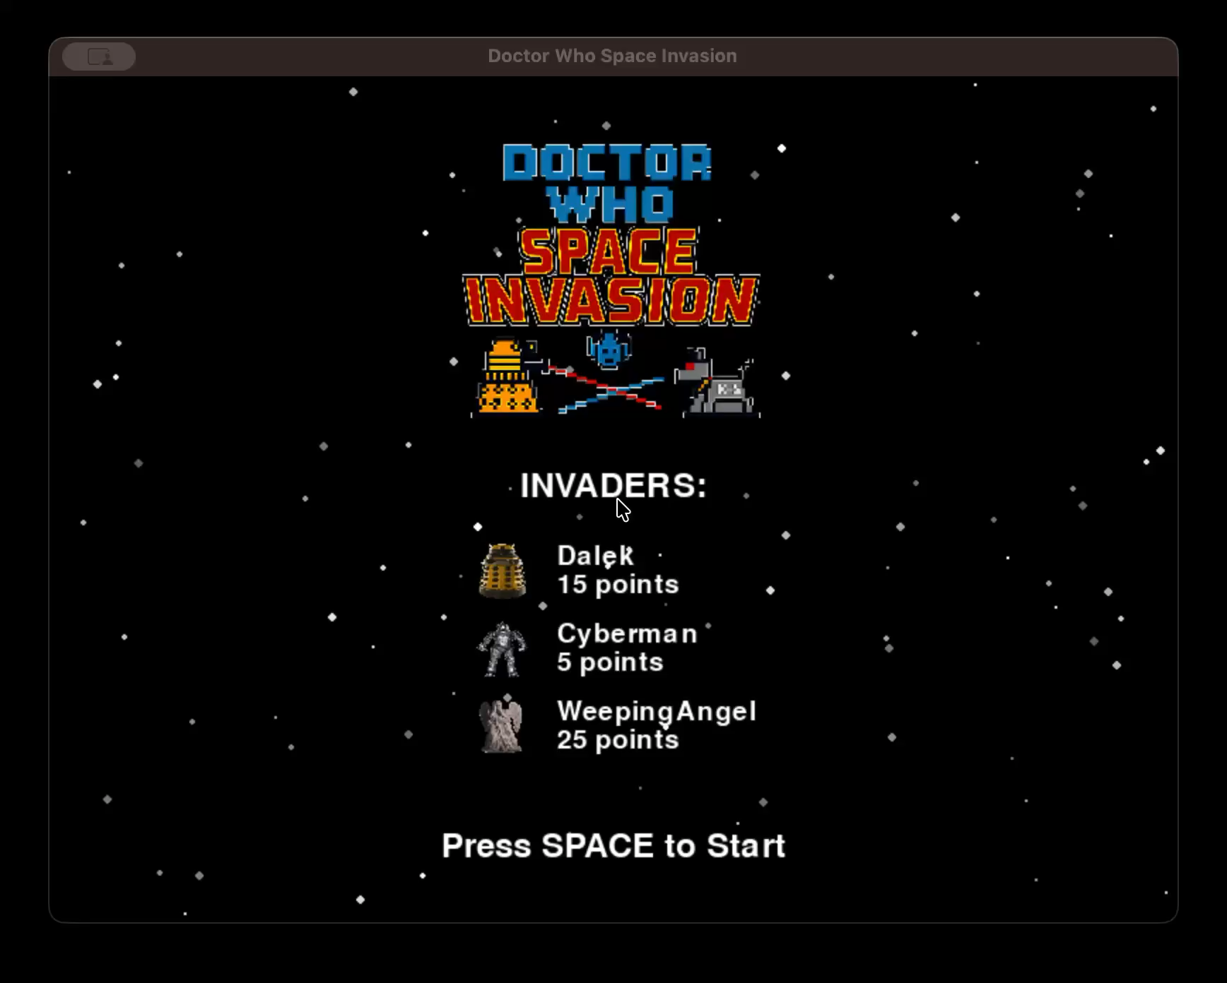
PyGame Demonstration

Slide 3
Requirement 1
The full invaders array should include the three types of aliens. These should move
from side to side, and fire at the player at random. Their speed of movement should increase as the
invaders are reduced in number (from being shot).

Slide 4
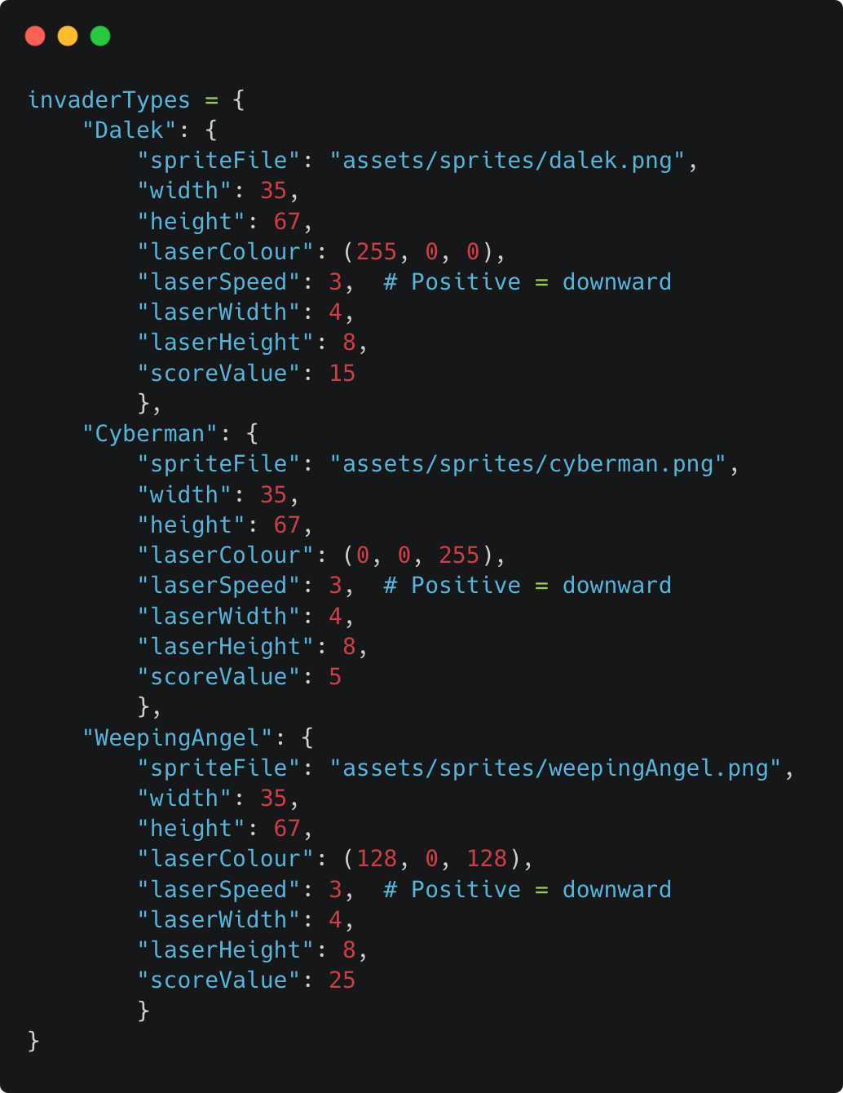
Invader Types
We defined three invader types in the invaderTypes dictionary: Dalek, Cyberman, and WeepingAngel. Each type has unique properties including sprite file, dimensions, laser colour (RGB tuple) and scoreValue for points awarded on destruction. During grid creation, random.choice() selects from invaderTypes.keys() to populate the invaders list with a random mix of all three types.

Slide 5
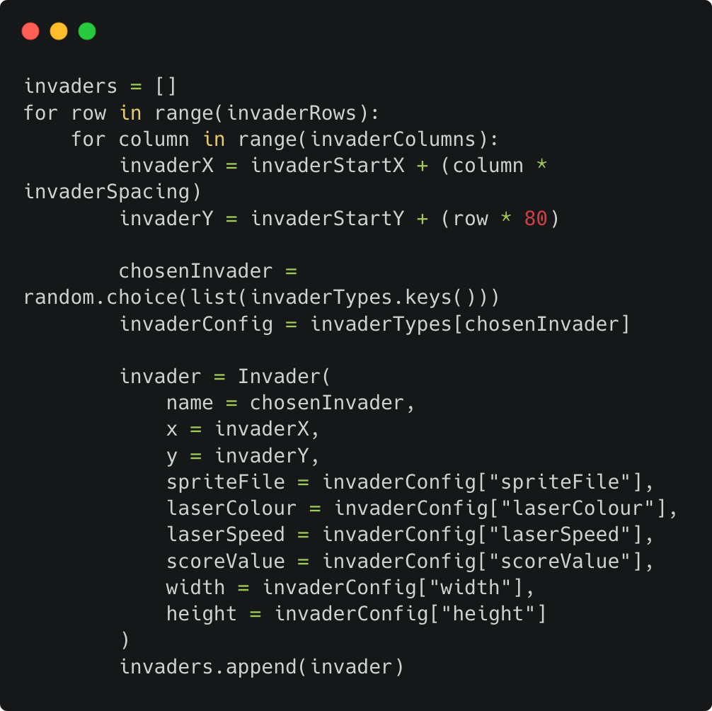
Invader Grid Creation
We use nested loops to create a grid of invaders based on invaderRows and invaderColumns from the game configuration. For each grid position, x/y coordinates are calculated using invaderStartX, invaderStartY, and invaderSpacing. A random invader type is selected from the invaderTypes dictionary and instantiated as an Invader object and then appended to the invaders list.

Slide 6
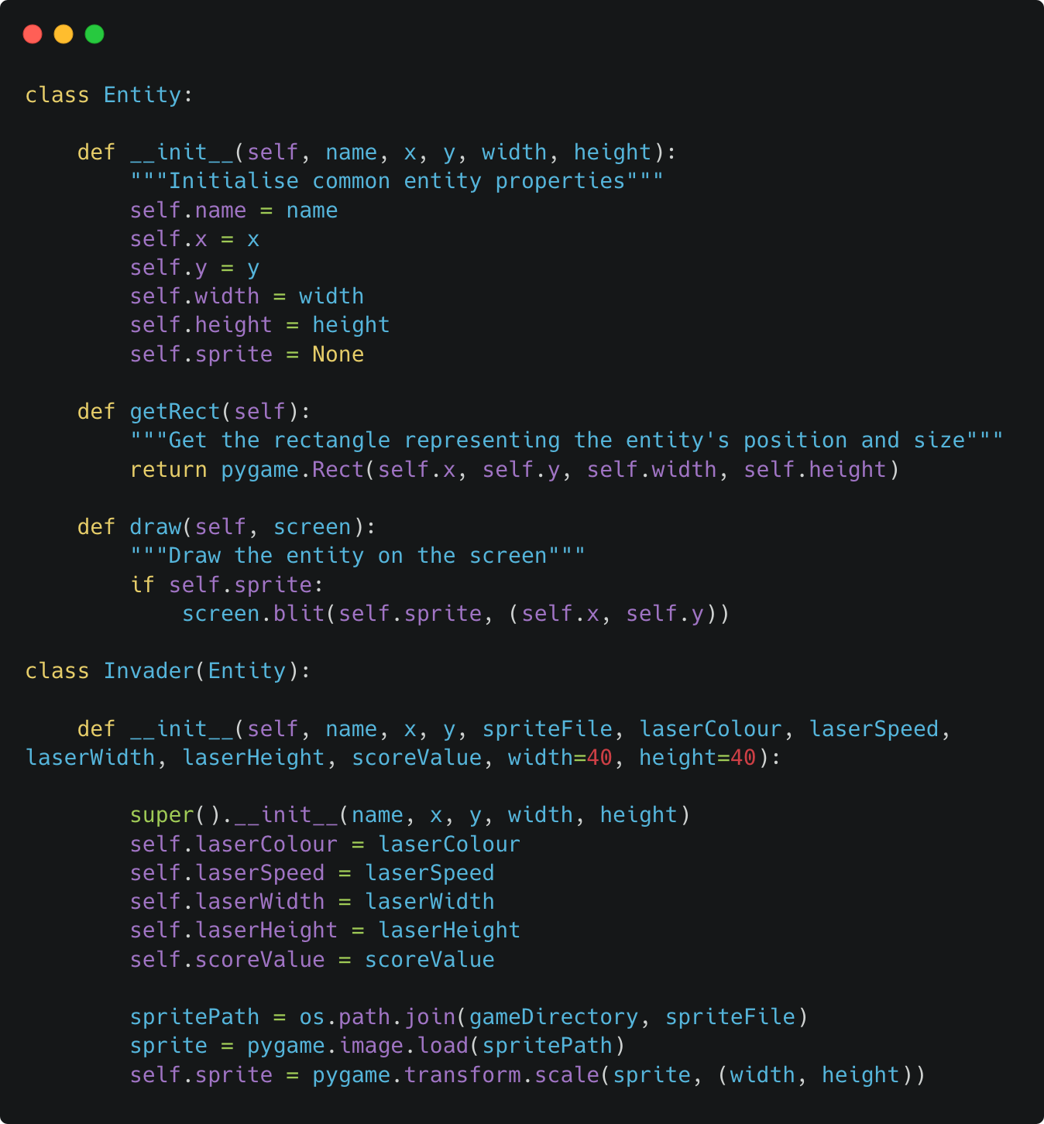
Invader Class
Each invader was created as an instance of the Invader class which inherits from Entity. Inheritance allowed us to reuse common attributes such as x, y and width as well as height while giving invaders their own projectile properties. This reduced duplication and kept the structure consistent with the object-oriented approach taught in the module. The Entity class serves as the base blueprint for all drawable game objects and by calling super().init() inside the Invader constructor it meant we were able to initialise all shared properties in one place instead of redefining them for every type of invader. This made the Invader class cleaner, easier to maintain and therefore fully consistent with the rest of the game’s object system.

Slide 7
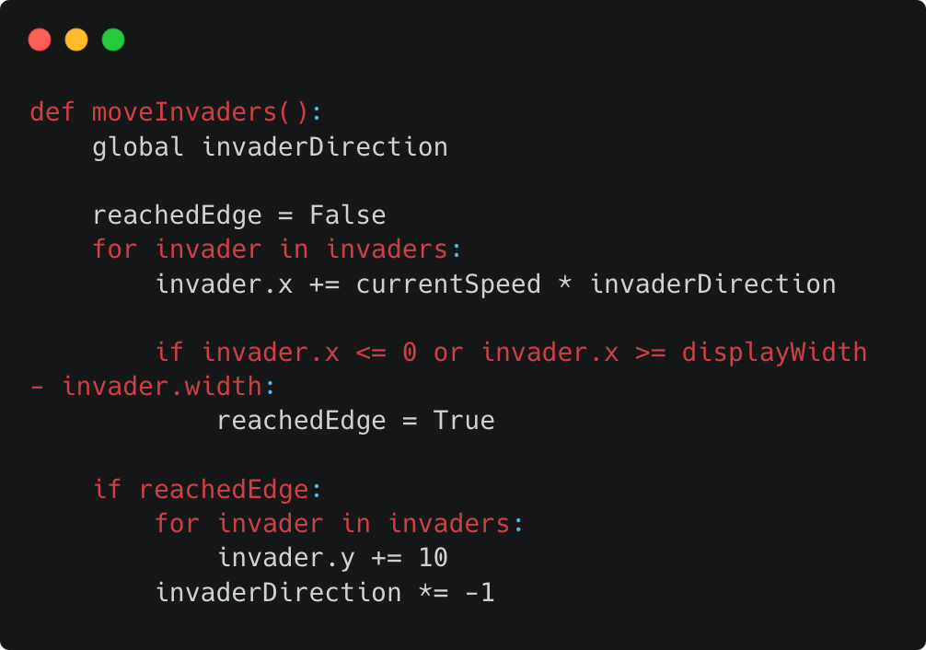
Side to Side Movement
The moveInvaders() function iterates through all invaders, updating their x position by currentSpeed * invaderDirection. The invaderDirection variable is either 1 (right) or -1 (left). When any invader reaches the left or right edge of the screen, all invaders move down by 10 pixels and invaderDirection is multiplied by -1 to reverse direction.

Slide 8
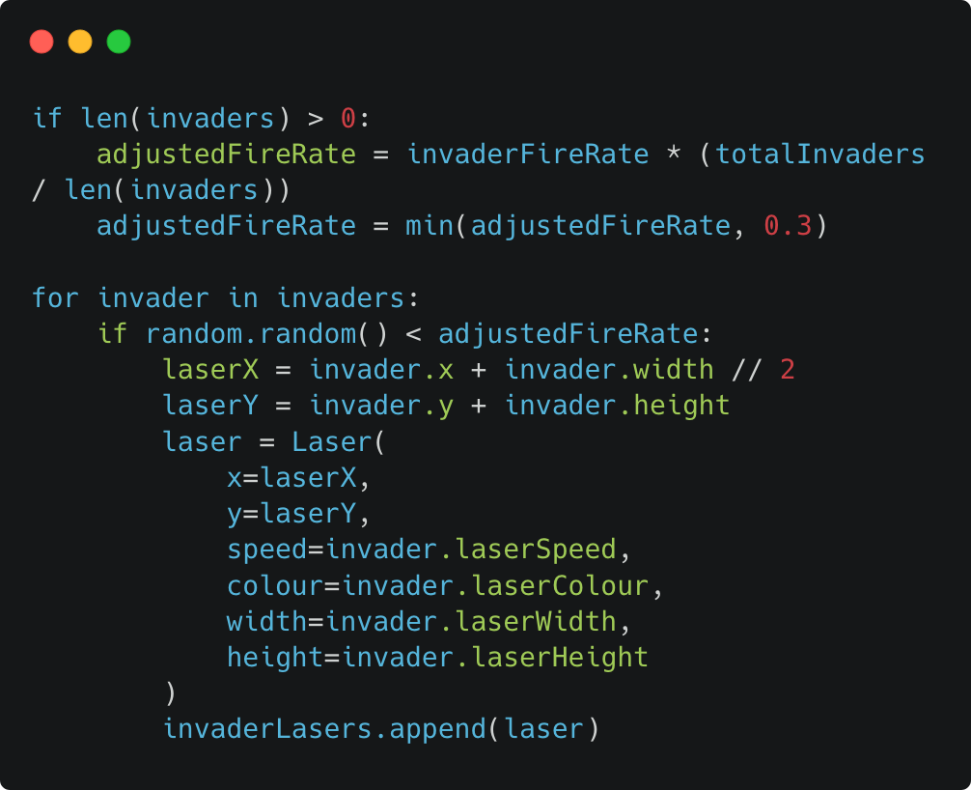
Random Firing
Each frame, every invader has a chance to fire based on invaderFireRate (0.1% is the base probability). We use random.random() to generate a value between 0 and 1.If it falls below the adjusted fire rate, a new Laser is instantiated at the invader's position and appended to invaderLasers. The fire rate is dynamically adjusted based on remaining invaders to maintain consistent attack pressure.

Slide 9
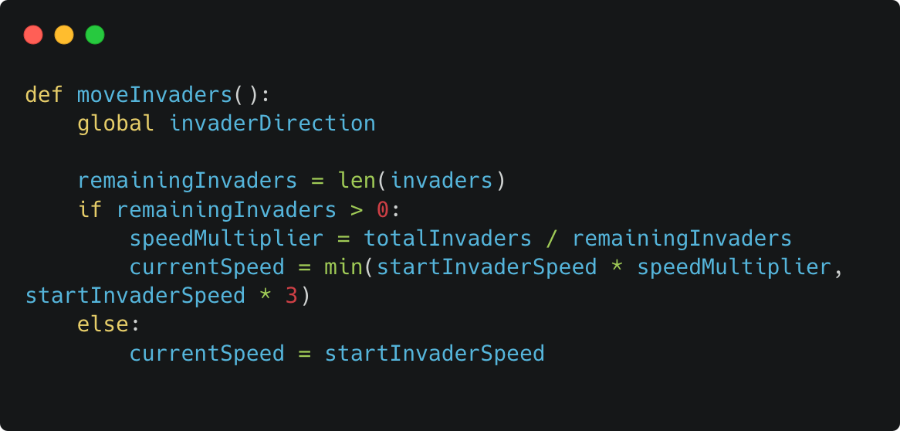
Dynamic Speed Increase
Within moveInvaders(), we calculate a speedMultiplier by dividing totalInvaders (original count) by remainingInvaders. This means fewer invaders results in a higher multiplier. The currentSpeed is calculated as startInvaderSpeed * speedMultiplier, capped at 3x the original speed using min() to prevent unplayable speeds. This creates escalating difficulty as the player progresses.

Slide 10
Requirement 2
The defender (player) should be able to shoot multiple bullets continuously. Implement collision detection so that invaders are destroyed when successfully shot by the player, and that the player loses a life and respawns (until they run out of lives) when shot by an invader.

Slide 11
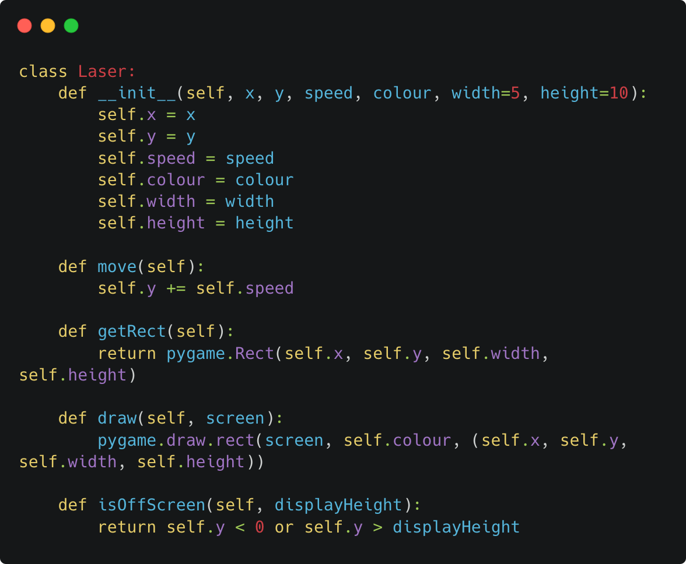
A Reusable Laser Class for Defenders and Invaders
We created a reusable Laser class to handle projectile mechanics for both the defender and invaders. The class encapsulates properties including x/y coordinates, velocity, RGB colour tuples and dimensions. The speed parameter differentiates trajectory direction. Negative values move upward (defender), positive values move downward (invaders).

Slide 12
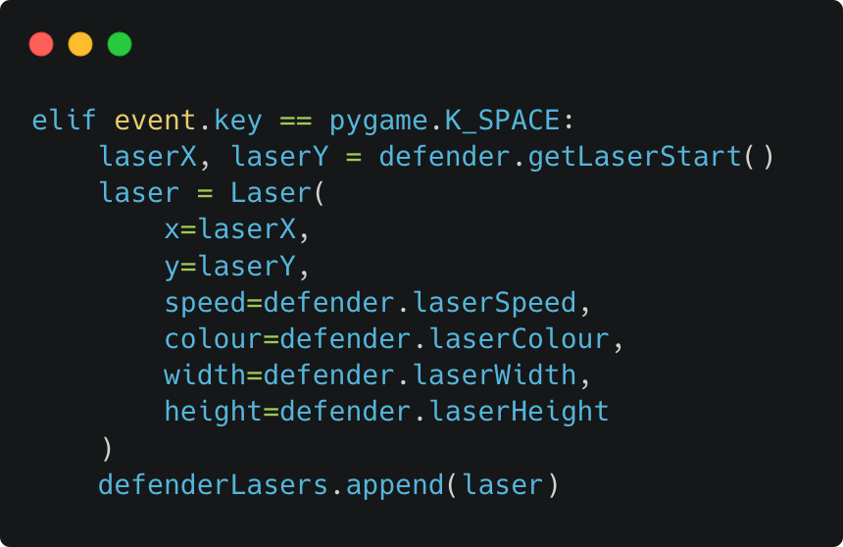
Creating Lasers On Player Input
On a KEYDOWN event for pygame.K_SPACE, a new Laser instance is instantiated at coordinates returned by defender.getLaserStart() and appended to the defenderLasers list. This list-based approach allows multiple projectiles to exist simultaneously therefore enabling continuous fire with no restrictions.

Slide 13
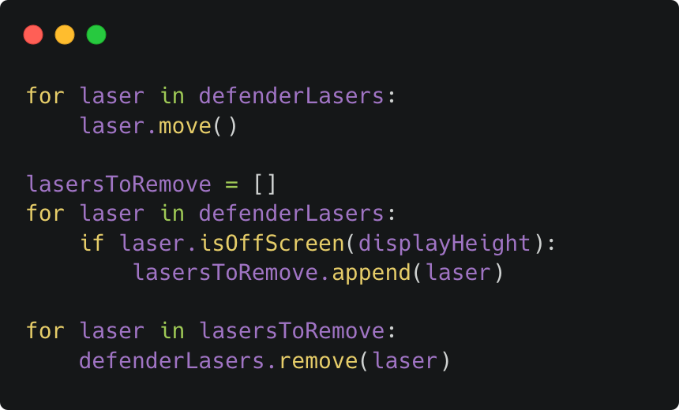
Moving, Rendering and Laser Garbage Collection
Each frame, the game loop iterates through the defenderLasers list, invoking move() to update positions and draw() to render each projectile. Garbage collection is performed by checking isOffScreen().Lasers that return "True" are removed from the list, preventing memory accumulation from orphaned projectiles.

Slide 14
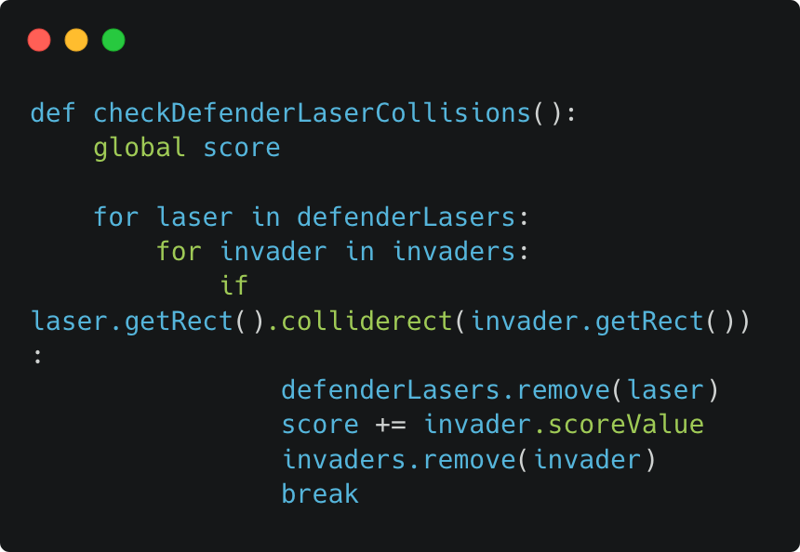
Detecting Laser Hits Using Bounding Box Collision
We used Pygame's colliderect() method for overlapping bounding box collision detection. Each entity has a getRect() method returning a pygame.Rect object representing its position and dimensions. When a defender laser collides with an invader, both objects are removed from their respective lists and the player's score increases based on the invader's scoreValue property of the invader.

Slide 15
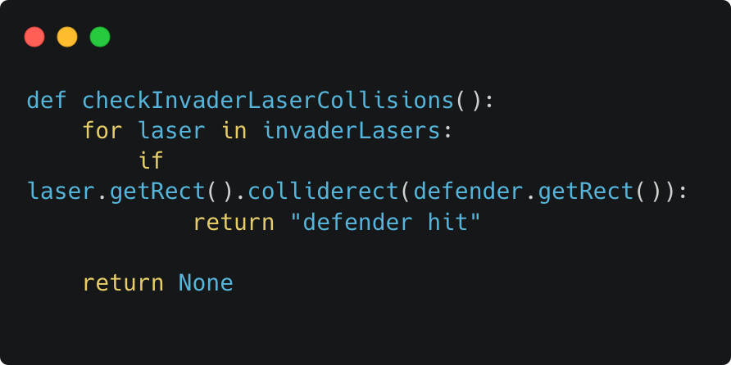
Player Hit Detection
The checkInvaderLaserCollisions() function iterates through all invader lasers and checks for collision with the defender's bounding box. If a collision is detected, the function returns "defender hit" which triggers the lives system in the main game loop.

Slide 16
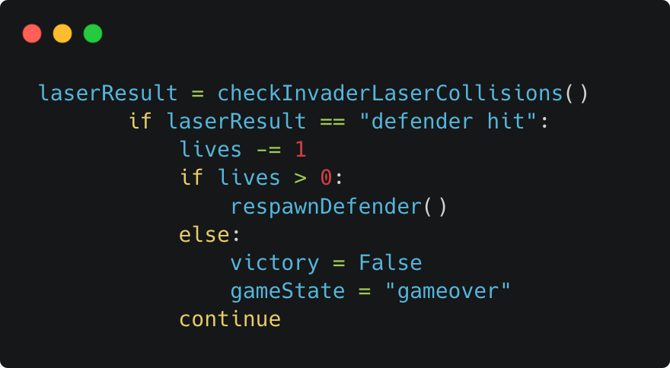
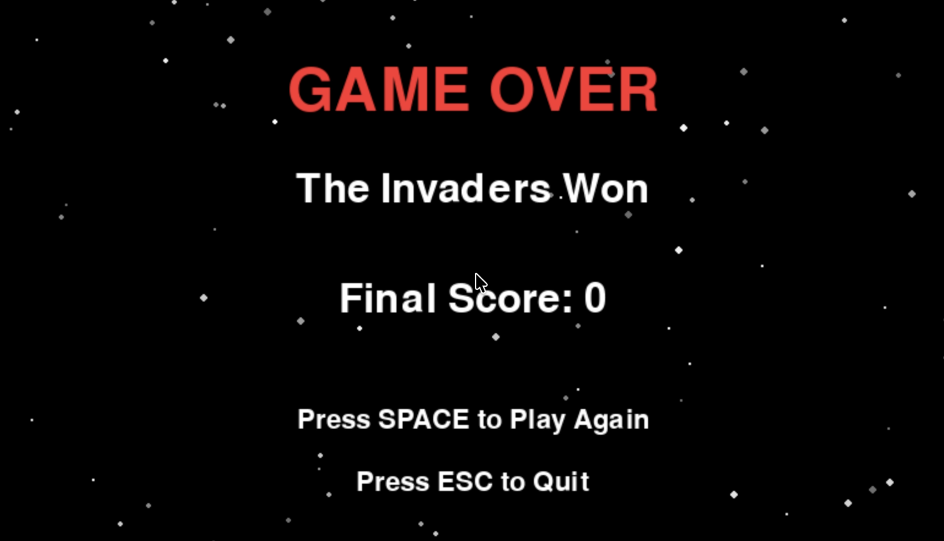
Lives and Respawn
The player starts with lives = 3. When checkInvaderLaserCollisions() returns "defender hit", lives is redcued. If lives remains above zero, respawnDefender() resets the defender's position to centre-bottom and clears all active lasers from the screen. If lives reaches zero, gameState is set to "gameover" ending the game.

Slide 17
Requirement 3
The four green barriers should diminish every time they are shot by both the invaders
and the defender/player.

Slide 18
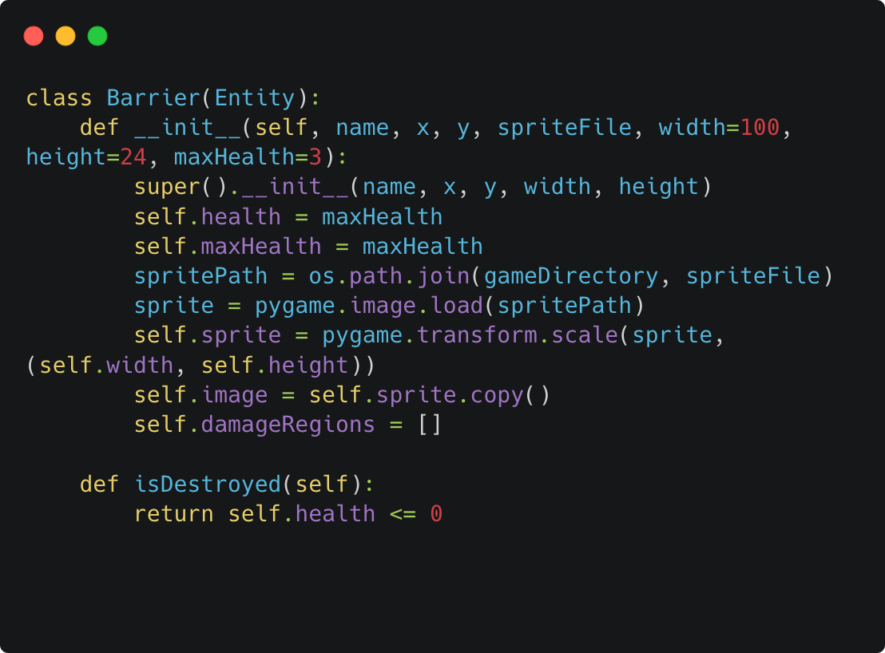
The Barrier Class
We created a Barrier class extending the base Entity class, with a health system and visual damage feedback. Each barrier is initialised with maxHealth (default 3) and maintains a damageRegions list to track accumulated damage. The class provides takeDamage() to decrement health and apply visual damage, isDestroyed() to check if health has reached zero, and a custom draw() method that renders the damaged sprite.

Slide 19
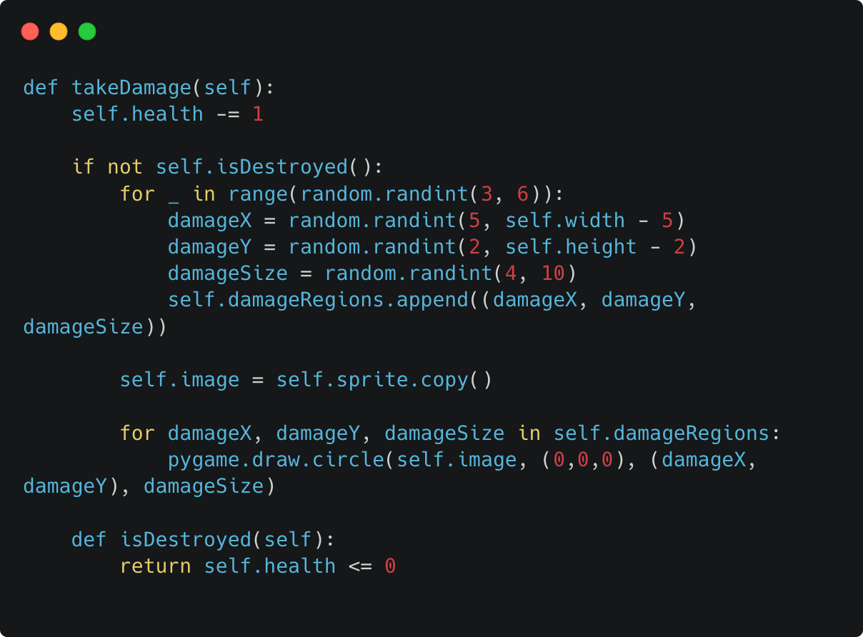
Visual Damage Mechanism
When takeDamage() is called, health is decremented and random black circles are drawn onto the barrier sprite to visually represent damage. The damageRegions list accumulates (x, y, size) tuples, and on each hit the sprite is redrawn with all accumulated damage using pygame.draw.circle(). This creates a progressive deterioration effect until the barrier is destroyed.

Slide 20
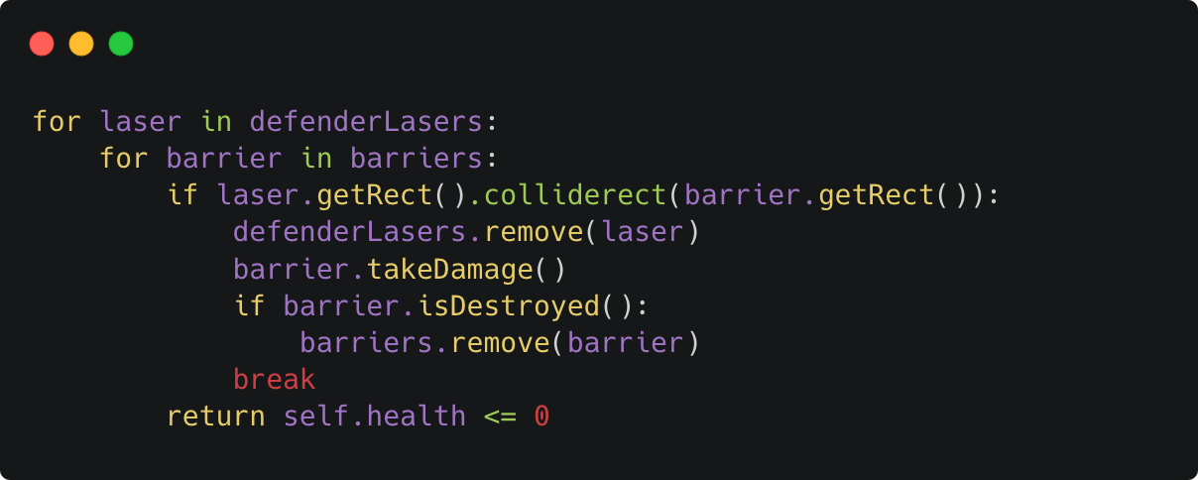
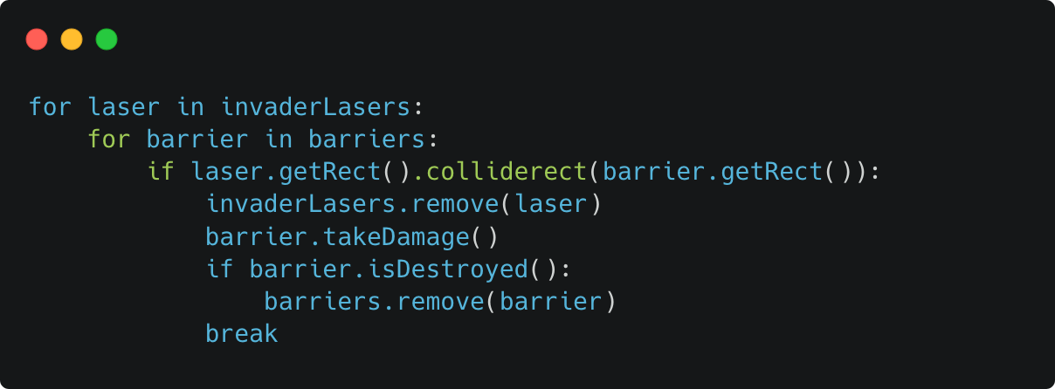
Barrier Collision Detection
Both checkDefenderLaserCollisions() and checkInvaderLaserCollisions() check for laser-barrier collisions using colliderect(). When a collision is detected, the laser is removed, takeDamage() is called on the barrier and if isDestroyed() returns True it means the barrier is removed from the barriers list. This ensures barriers diminish from fire by both sides.

Slide 21
Beyond The Requirements
Flow Between Game Screens
We used a gameState variable to control which screen is displayed. The game begins on the title screen, and pressing SPACE starts the main game. When the player loses all lives or destroys all invaders, the game over screen appears. From here, pressing SPACE resets all game variables and returns the player to the main game for another attempt.
Easily Expandable Configuration for Invaders, Defenders and Barriers
We designed the game to be easily expandable using configuration dictionaries for invaders, defenders, and barriers. Each dictionary stores the properties for different entity types, and the game randomly selects from whatever types are available. This means adding a new invader or defender is as simple as adding a new entry to the dictionary, no other code changes needed. For example, adding a "Sontaran" invader would immediately make it appear randomly in the game alongside Daleks, Cybermen, and Weeping Angels.
Different Points for Different Invaders
Each invader type awards a different number of points when destroyed, adding strategic depth to the game. Cybermen are worth 5 points, Daleks are worth 15 points, and Weeping Angels are worth 25 points. When a defender laser hits an invader, the invader's scoreValue is added to the player's total score. This encourages players to prioritise higher-value targets while balancing risk and reward.

Slide 22
Future Changes
Game Audio
The original Space Invaders game featured low-bit retro audio, while our current version includes no sound. The game could be enhanced by adding background music, as well as sound effects for collisions and different game states.
Testing
We tested the game by launching it directly and playing through it. However, this approach could be improved by introducing unit tests for individual methods, as well as integration tests to verify how the methods interact across the different Python files.
Introduce Additional Barriers and Defenders
The Python code uses random.choice() to select random invaders, defenders, and barriers from their respective configuration dictionaries. This modular design allows for easy expansion - we could add new Doctor Who characters as defenders with different speeds, laser colours, or laser speeds, new enemy types with varying health values and score points, or enhanced barriers with higher health values, all by simply adding new entries to the existing dictionaries without modifying the core game logic.

Slide 23
References & Resources
Credit and Tools
Sources & Credits: https://github.com/RobsonHarrison/com4023Cw1Pygame/wiki/Sources-and-Credits
Code Snippet Renders: https://carbon.now.sh/
Project Documentation
Repository: https://github.com/RobsonHarrison/com4023Cw1Pygame
Architecture: https://github.com/RobsonHarrison/com4023Cw1Pygame/wiki/Game-Architecture
Issue Tracking: https://github.com/RobsonHarrison/com4023Cw1Pygame/issues

